Slide 1


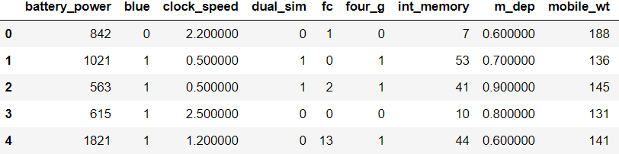
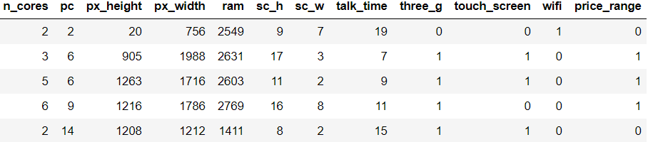
Dataset And It’s Variables

Slide 2


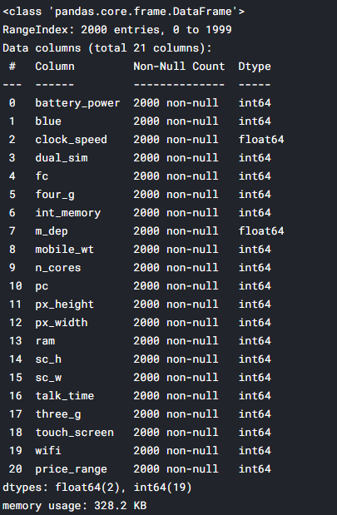

Data Analysis
Summery
Data Dimension

Slide 3


Machine Learning Models
Logistic Regression for Machine Learning
Logistic regression is a technique borrowed by machine learning from the field of statistics. It is the go-to method for binary classification problems (problems with two class values).
Logistic regression equation:
y = e^ (b0 + b1*x) / (1 + e^ (b0 + b1*x))
K-Nearest Neighbour’s Algorithm for Regression
KNN algorithm has easily been the simplest to pick up. Despite its simplicity, it has proven to be incredibly effective at certain tasks. It can be used for both classification and regression problems.
Gaussian Naive Bayes
Naive Bayes can be extended to real-valued attributes, most commonly by assuming a Gaussian distribution.
Decision Tree Classification Algorithm
Decision Tree is a Supervised learning technique that can be used for both classification and Regression problems, but mostly it is preferred for solving Classification problems.

Slide 4
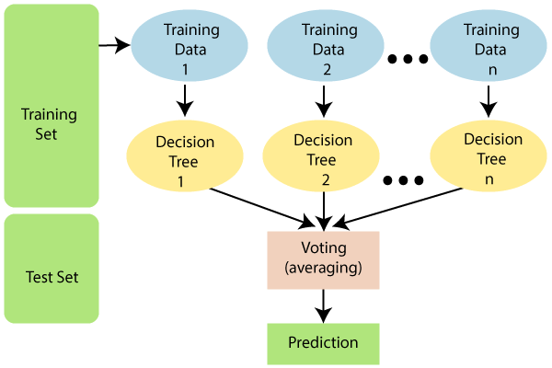
1.Information Gain:
Information Gain= Entropy(S)- [(Weighted Avg) *Entropy (each feature)
Entropy(s) = -P(yes)log2 P(yes)- P(no) log2 P(no)
2. Gini Index:
Gini Index= 1- ∑_{j}P_{j}²
Random Forest Algorithm
Random Forest is a popular machine learning algorithm that belongs to the supervised learning technique. It can be used for both Classification and Regression problems in ML.
The greater number of trees in the forest leads to higher accuracy and prevents the problem of overfitting.
The below diagram explains the working of the Random Forest algorithm:
AdaBoost Model
Ada Boosting is best used to boost the performance of decision trees and this is based on binary classification problems. It is used for classification rather than regression. It can be used to boost the performance of any machine learning algorithm. It is best used with weak learners.

Slide 5
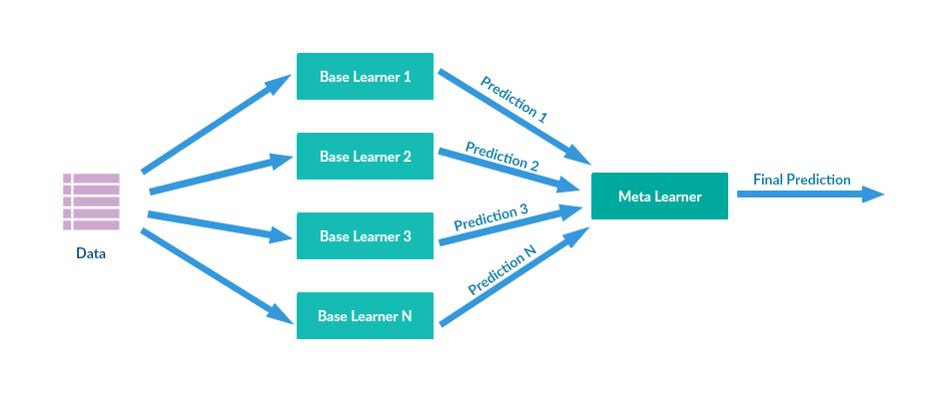
Gradient Boosting
It is an expansion of the boosting procedure.
Gradient Boosting = Gradient Descent + Boosting
XGBoost
XGBoost stands for eXtreme Gradient Boosting. It is an implementation of gradient boosting machines. This approach supports both regression and classification predictive modelling problems.
Stacking in Machine Learning:
Stacking is one of the three widely used ensemble methods in Machine Learning and its applications. The overall idea of stacking is to train several models, usually with different algorithm types (aka base-learners), on the train data, and then rather than picking the best model, all the models are aggregated/fronted using another model (meta learner), to make the final prediction. The inputs for the meta-learner is the prediction outputs of the base-learners.

Slide 6

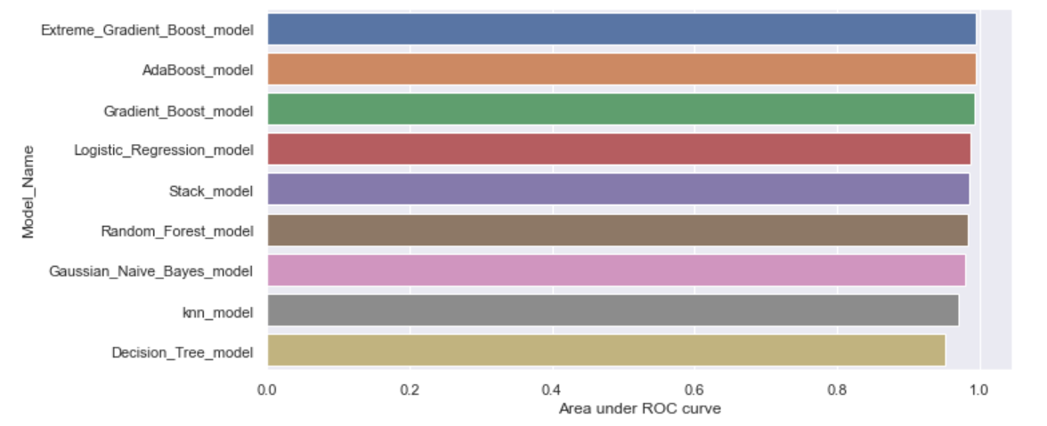
Model Performance

Slide 7

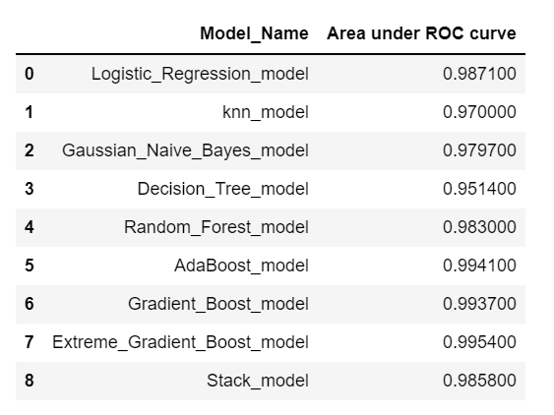
CONCLUSION
Best area under ROC was obtained by XGBoost model.

